Slide 1
Designing and Developing a System Under Pressure
Tutorial:
Architecture,
Vertical & Horizontal Slices
Advanced Software Engineering 475
Andrew McVeigh

Slide 2
Requirements & Analysis
A system to analyse and display weather information
  It takes data from a number of sources for a given day and shows the data for a given city
  It can average the data available to produce a report
Weather
Source
Accesses
Weather
Data Averager
Report
Supplies weather data
for...
Produces report for
Weather
Data
City
for

Slide 3
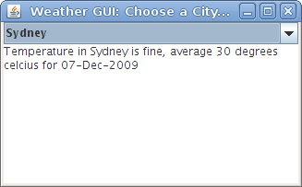
Vertical Slice Task
Aim:
Vertical Slice to show end-to-end report generation and data averager working
  Just provide dummy weather data, doesn't matter how
  Put in interfaces to allow horizontal slice next:
    the weather sources and cities will eventually come from real places
  Use the Eclipse project on CATE (in Java) or make your own in any language...
    week 9 – weather.zip file in notes section
    Use File/Import Existing Projects/Archive file
  Keep in mind: we want a list of cities,
  and to have a set of sources
  Need to agree a common data
  formats to return

Slide 4
Horizontal Slice Task
Take the weather and city information from a file
  We shouldn't have to change the interfaces that are there
  OR if you are feeling ambitious...
Get the cities and weather information from the internet in your program
  But, perhaps web-scrape the data from the following sites:
  http://en.wikipedia.org/wiki/List_of_cities_proper_by_population
  Perhaps get the weather from some of the following:
  http://www.weather-forecast.com/locations/Eastlondon/forecasts/latest
  http://www.wunderground.com/cgi-bin/findweather/getForecast?query=karachi&wuSelect=WEATHER

Slide 5
Quick Check
Did you have to change interface between the vertical and horizontal slices?
  Shouldn't have to. Interface is a design task.
Did you unit test!?
  If not go back and do this now

